Slide 1
PHYS60022 Data Science and Machine Learning for Physics
Week 10: Convolutional Neural Networks
Patrick Dunne, p.dunne12@imperial.ac.uk

Slide 2
Learning Outcomes
Learning outcomes for today
Loss curves
Introduce the concept of convolutional neural networks (CNN)
Introduce the concept of data volumes
Introduce pooling and other CNN hyperparameter choices
Know how to make basic choices of CNN architecture
Know how to use pytorch to set up and train a convolutional neural network
Update for last week, there was a bug in exercise 4
Binary Cross Entropy loss function already has in built ‘softmax’ to convert scores to probability-like values that add up to 1. Adding extra sigmoid layer at the end of network on top of this can lead to unstable gradients so we have taken this out and updated blackboard.
Shorter lecture today, focus on applying all of the skills you’ve learned so far including performance metrics

Slide 3
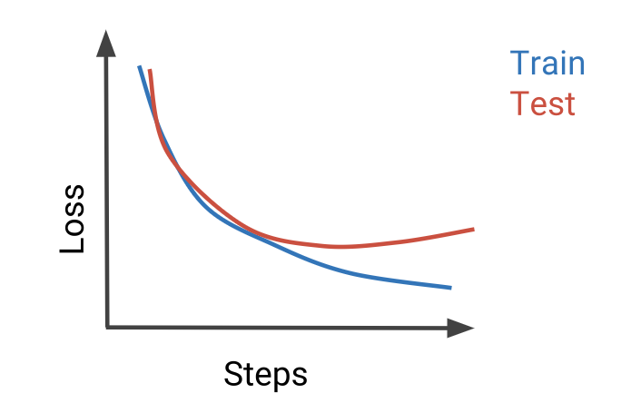
Loss Curves
Described last week how you need to check for overfitting by comparing train and validation data
How exactly?
Key metric is train vs validation loss as a function of epoch
Main overfitting signal is diverging train and test loss
Some good examples of interpreting loss curves here: https://developers.google.com/machine-learning/crash-course/overfitting/interpreting-loss-curves

Slide 4
Convolutional Neural Networks

Slide 5

Why do we need convolutional neural networks?
Ie what’s wrong with fully connected networks

Slide 6
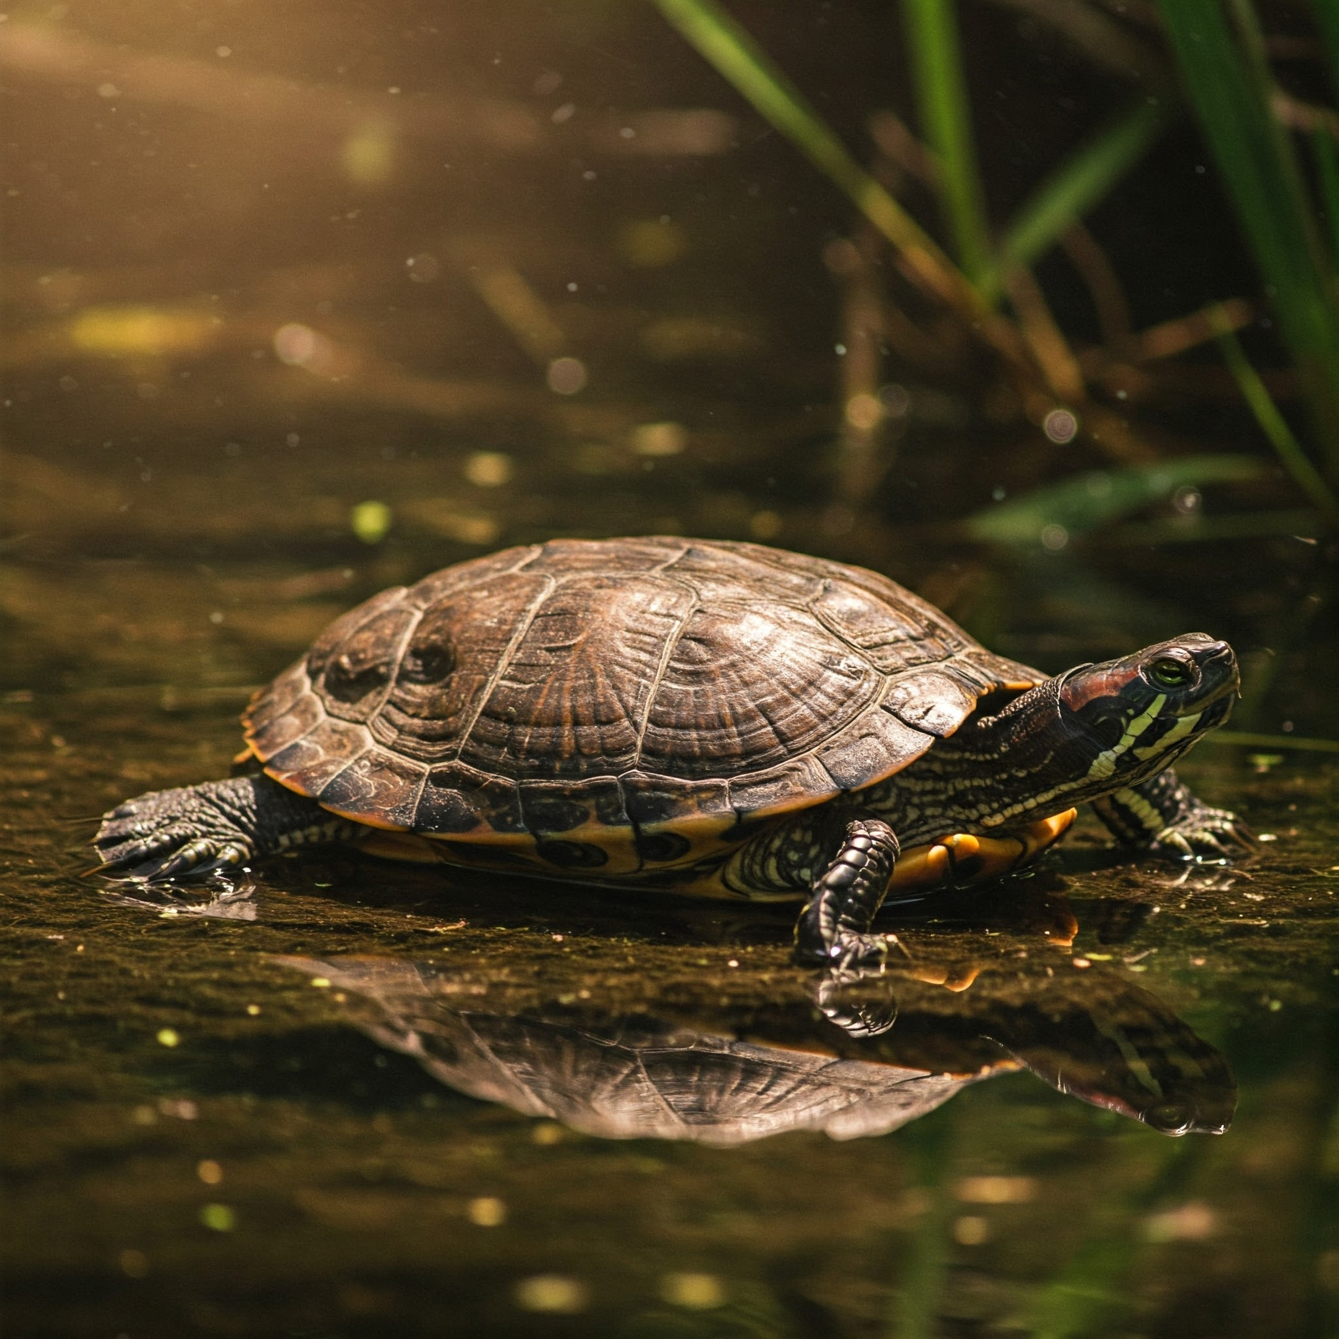
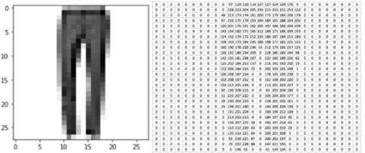
Fully connected networks for computer vision
Every FashionMNIST image is a 28x28 pixel greyscale image
If I want a neural network with one hidden layer containing 512 neurons that takes a FashionMNIST image as input how many weights are in that layer?
Is that useful?
How about a full colour HD image?
Google gemini “generate an HD image of a turtle”
Notes:
401k in FashionMNIST
~3 billion in HD

Slide 7
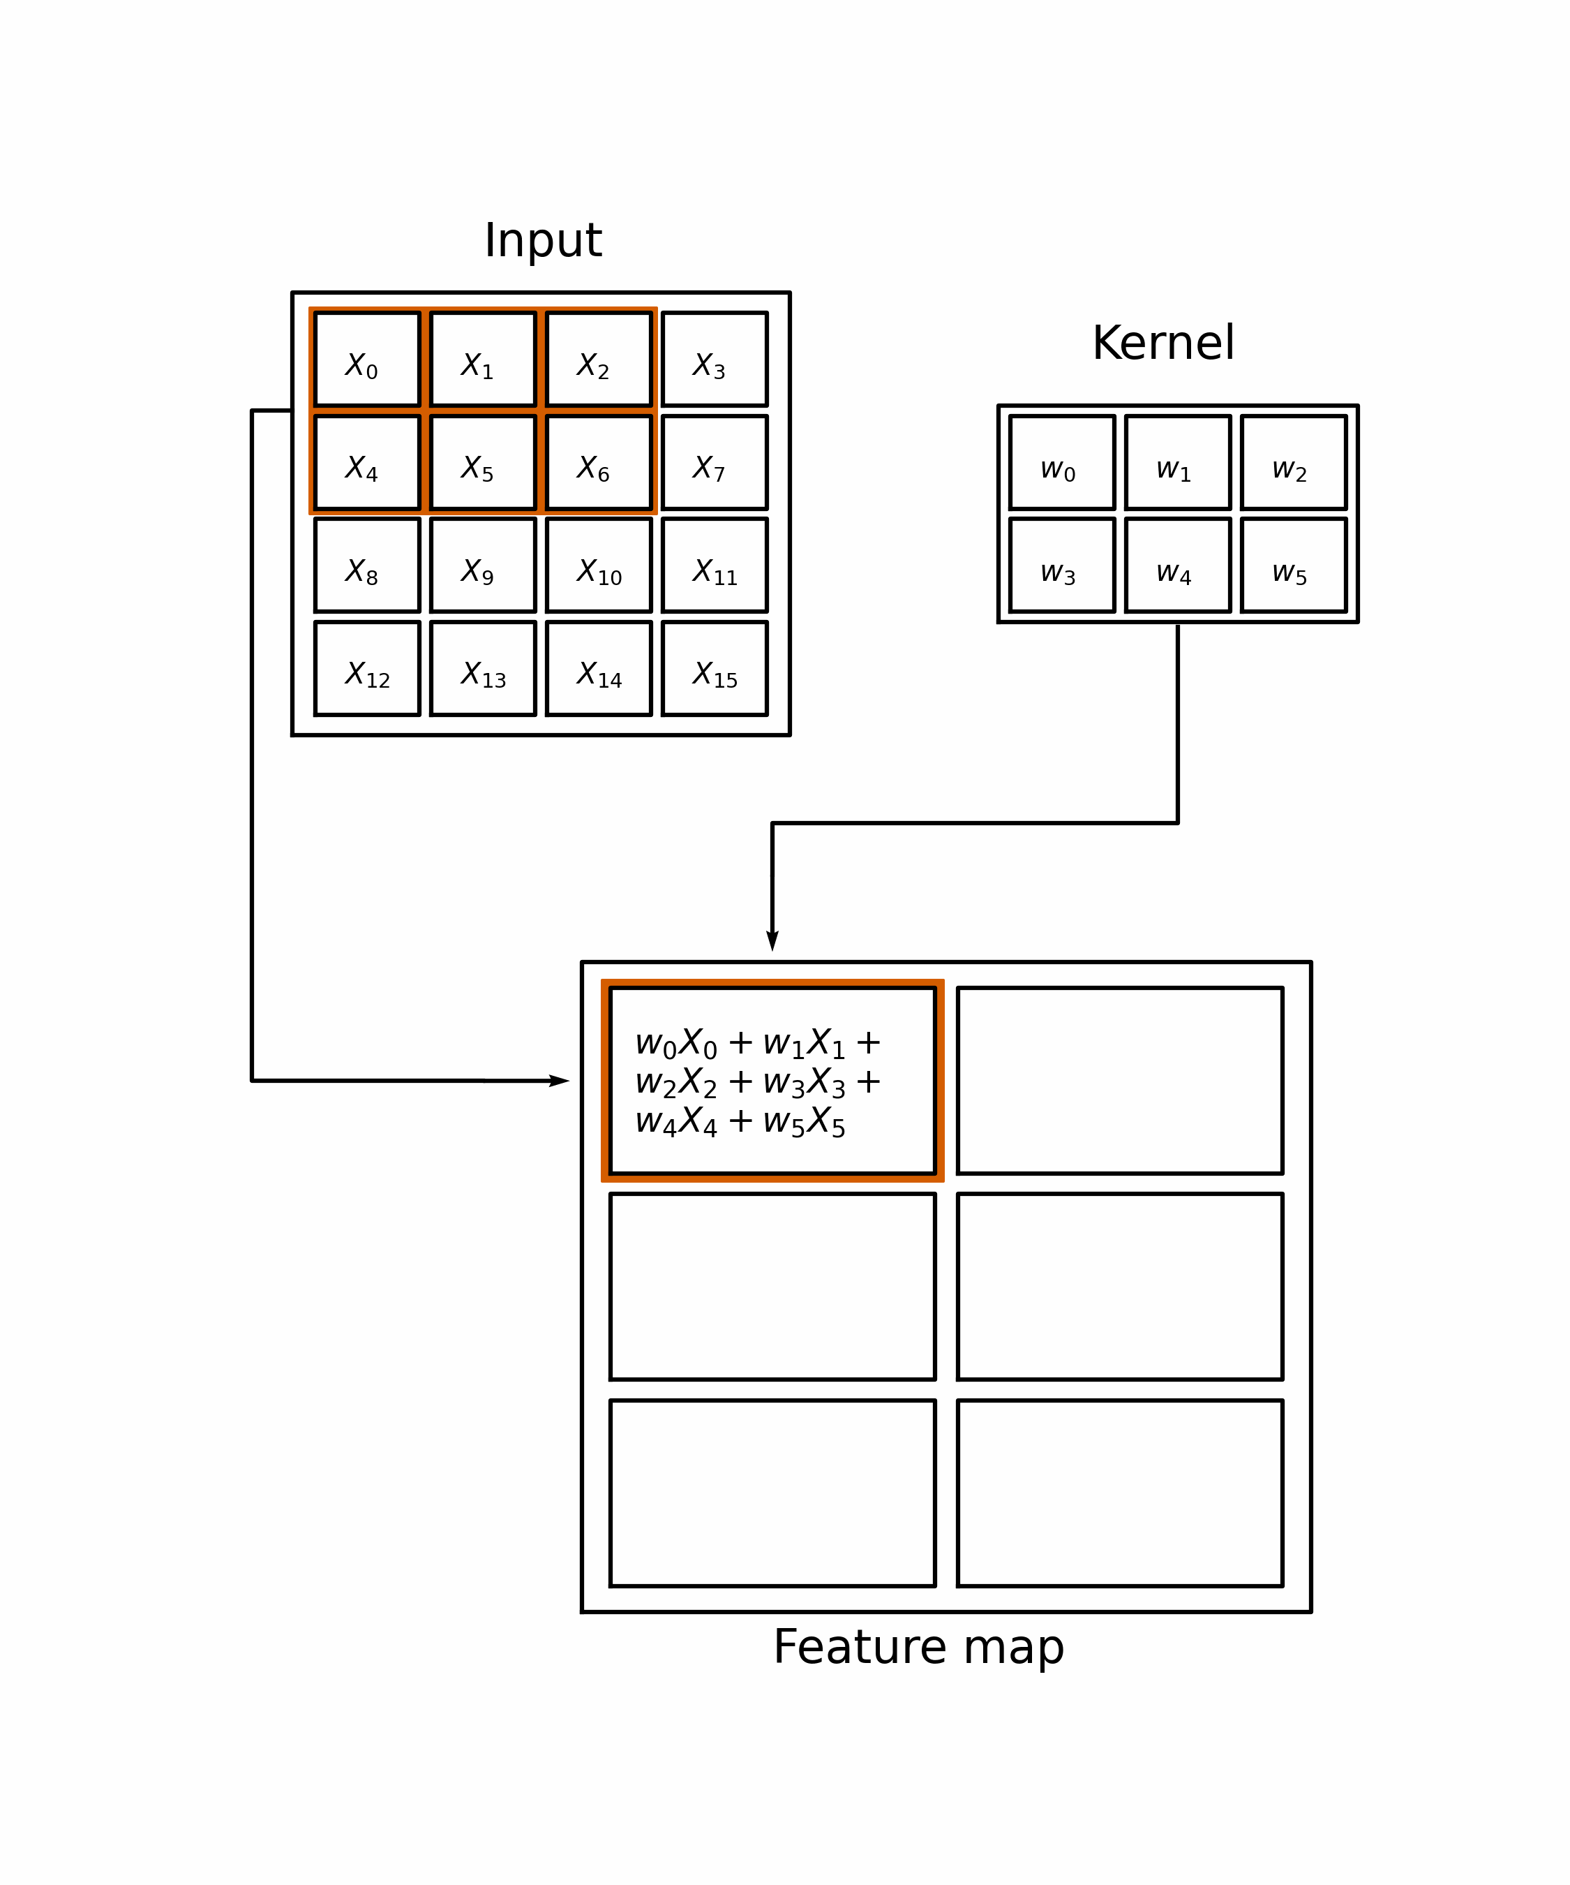
Convolutions
Information in a pixel is much more likely to be relevant to the surrounding pixels than ones on other side of the picture
Looking for mathematical operation that considers pixel and those around it but can be applied to whole image
For any pixel result of convolution is a weighted sum of a small group of pixels around it
Perfect!
In a convolutional neural network (CNN) operation taking you to next layer is convolving current layer with a set of kernels
What you learn is the kernel matrices!

Slide 8
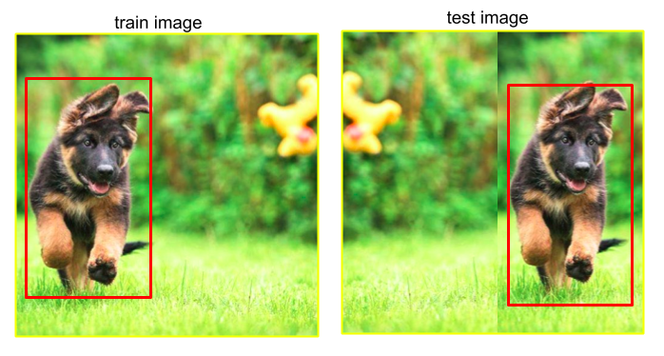
Key advantages of convolutions
Re-use of parameters:
Far fewer parameters to learn
512 5x5 kernels is 13k parameters and you probably don’t need that many
Translational invariance:
It’s the same kernel being scanned across the whole image
Can find the dog/cat wherever it is
https://medium.com/towards-data-science/neural-networks-intuitions-8-translation-invariance -in-object-detectors-21db6e27879c

Slide 9
VSCode Demonstration
Convolutions on dollar bill image

Slide 10
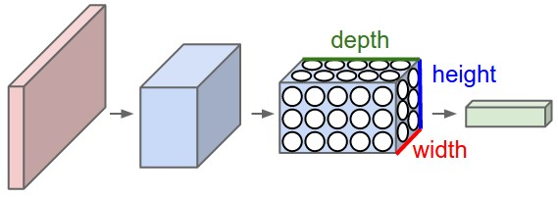
Controlling the size of CNNs
CNNs might not need so many parameters trained but how about the size of those data volumes
HD image uncompressed is ~10MB
Few layers with tens of kernels and you need GB of RAM to carry out your CNN
Even worse if you want a classification or regression output you still need to collapse result down to one number
Likely still need that massive fully connected layer

Slide 11
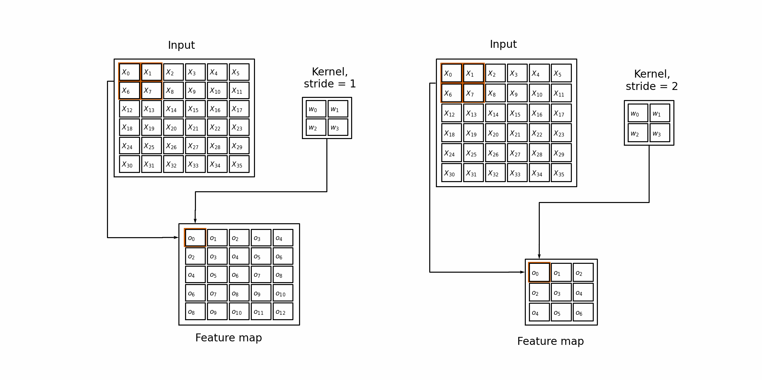
Controlling the size of CNNs
Stride
If I have an nxn kernel I won’t miss much if I move it n/2 pixels at a time instead of 1 pixel at a time
Fancy name is stride
Reduces size This gets us a factor of a few in each dimension

Slide 12
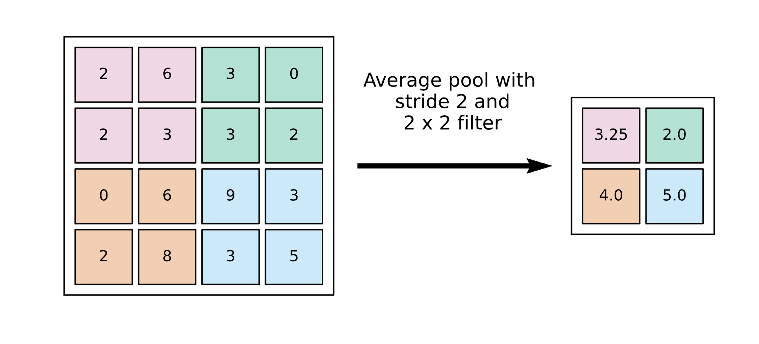
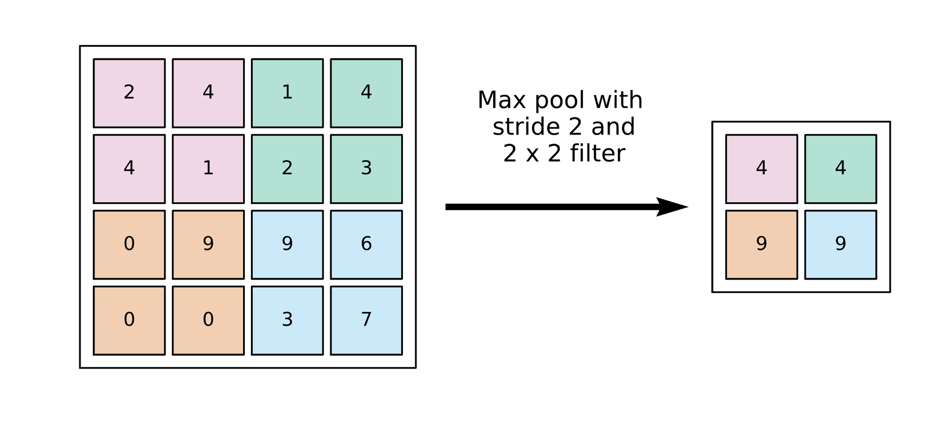
Controlling the size of CNNs
Pooling
In a large image you probably don’t care about response of every pixel
You do want to know if you had a strong reaction to any of the kernels in a broad region of your image
Pooling groups together pixels via any mathematical operation you like
Most common choice is max pooling
Max preserves strong local responses so better than average pooling which dilutes them

Slide 13
A basic CNN architecture
As with any network aim is to go from input dimension to dimension of your problem
For classification commonly a 1D vector same length as number of classes
For regression often just a single number
Some generative techniques might have an image as output
Common architectures alternate convolution layers with pooling layers
Then go to fully connected layers to achieve desired output dimensionality

Slide 14
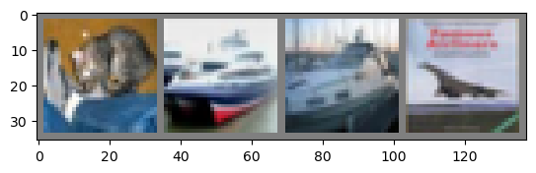
Exercises!
New dataset for this week is Cifar10
More complex images than FashionMNIST
Apply skills to this and other datasets we’ve seen already
As before even if you’ve done neural networks before you need to learn how to do them using pytorch for this course

Slide 15
Geometry beyond CNNs
Next week’s bonus lecture

Slide 16
Exercises!

Slide 17
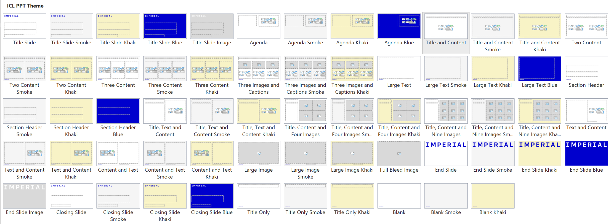
Notes to the template
Custom layouts and example slides
The template includes a range of predefined layouts that you can insert. These have been designed to cater for text, text and images and for picture arrangements. There are also layouts for Title and Divider slides.
Each custom layout includes the correct colour palette, type levels and formatting.
You can choose one of the layouts using the ‘New Slide’ button on the Home tab. You can also change the layout for a current slide using the ‘Layout’ list on the Home tab.

Slide 18
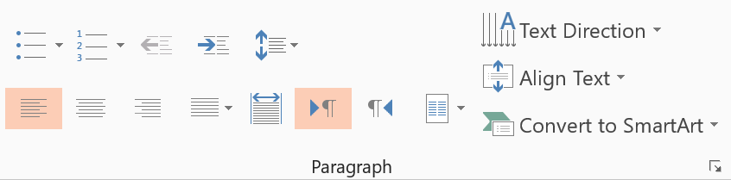
Notes to the template
Type levels and bullets
The standard text area has five predefined type levels.
You can move up or down the levels using the increase or decrease indent buttons in the home tab.
We recommend that you do not use the bullet button, as this does not apply the correct bullet formatting.
Level one is for general text
Level two is for subheadings within body copy
Level three is the first level of bullets
Level four is the second level of bullets
Level five is the third level of bullets
While text boxes are formatted to be the correct font, size, and colour, they will not contain the levels as a placeholder does. Therefore, it is recommended that you copy an existing text placeholder on the slide if you would like to insert a text box, to preserve the use of these levels.
Decrease list level
Increase list level

Slide 19
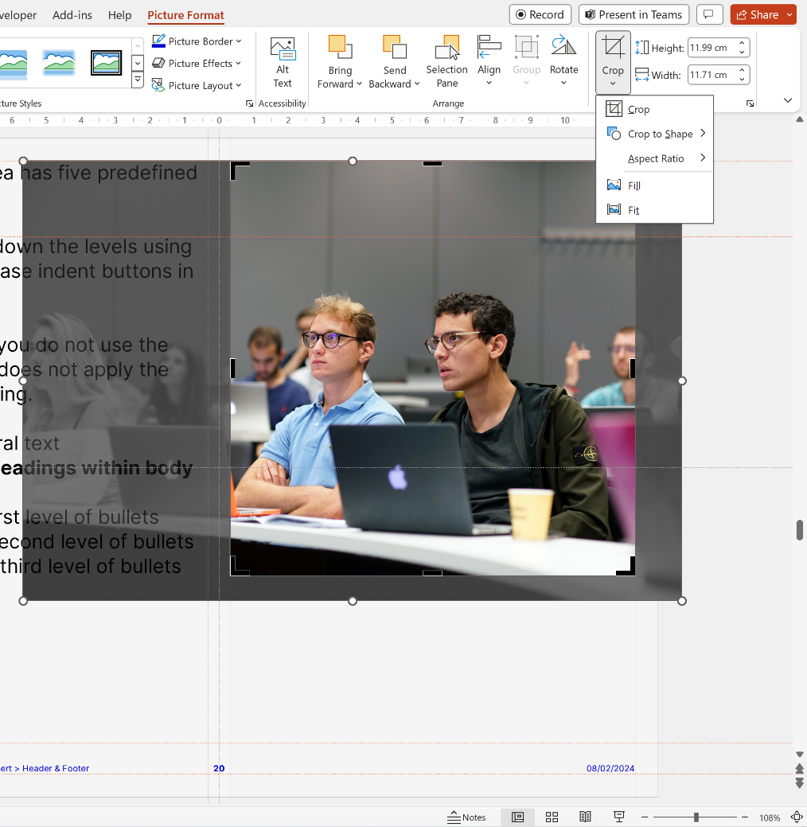
Notes to the template
Using picture slide layouts
The picture slides are predefined with picture placeholders that help you to manage the image you add into the field.
Click the button in the middle of the field to select and import the picture you want to use. The picture field will automatically fill the field with the image.
You can edit the position of the image using the crop tool, which is in the ‘Picture Tools > Format menu. This menu appears when you click on an image.
The crop tool allows you to enlarge, adjust position or crop the image to fit.

Slide 20
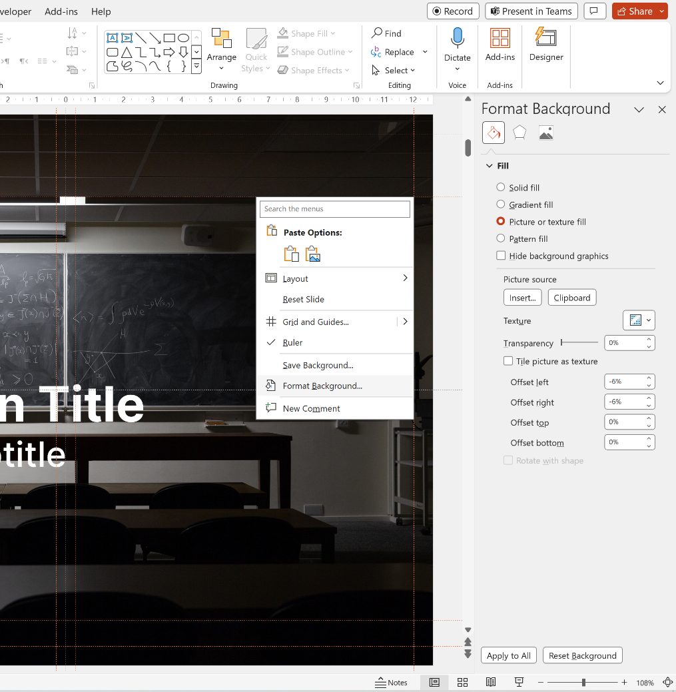
Notes to the template
Applying images to backgrounds
If you insert a Title or End Slide Image layout, you will find that the background is filled with a solid grey. This means that you can insert your own image to the background.
The first step is to right-click the background and choose Format Background – this will open a panel on the right of the screen.
Then, tick the Picture or texture fill box, and choose Insert Picture from File. Select an image from your computer, ensuring it follows brand guidelines, and the picture will automatically fill the background of the slide.

Slide 21
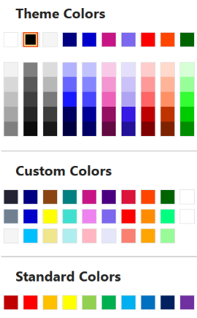
Notes to the template
Tips and recommendations
Type levels
Always use the type levels in the predefined content placeholders, supplied with each layout.
Text boxes
If you use text boxes, please note that they do not include the type levels. Any formatting has to be manually applied, and we recommend you adhere to the brand rules.
Footers
The footer and page number can be modified and turned on or off. To do this, go to the Insert tab on the ribbon, then click Header and Footer.
Colour palette
Always select a colour from the supplied colours.
The top row represents the correct brand colours and are automatically used in charts and diagrams.
The Custom Colors section contains all of the brand colours, some in multiple tints. Please use these as required.
The Standard Colors row is supplied by Office and does not follow brand guidelines. Please do not use these colours in your documents.

Slide 22
Thank you
Presentation Title
DD/MM/YYYY

